Slide 1
HCL Patient Data Registry Project: Project Update
Leslie Andritsos, MD
Professor of Internal Medicine
Mirela Anghelina, MD, MPH
Clinical Research Coordinator

Slide 2
HCLF Patient Data Registry
Conceived of and funded by patients
Created by the HCL Foundation in collaboration with hairy cell researchers and biomedical informatics specialists
Immediate goals
To increase knowledge of the disease
Improve the lives of patients with HCL
Future goals:
Facilitate clinical and translational research
Serve as a platform for future studies

Slide 3
Registry Participation
2 ways to participate:
Enroll in person at a Center of Excellence that is participating in the study
Enroll via the web portal if not treated at a participating site www.hairycellleukemia.org

Slide 4
www.hairycellleukemia.org

Slide 5
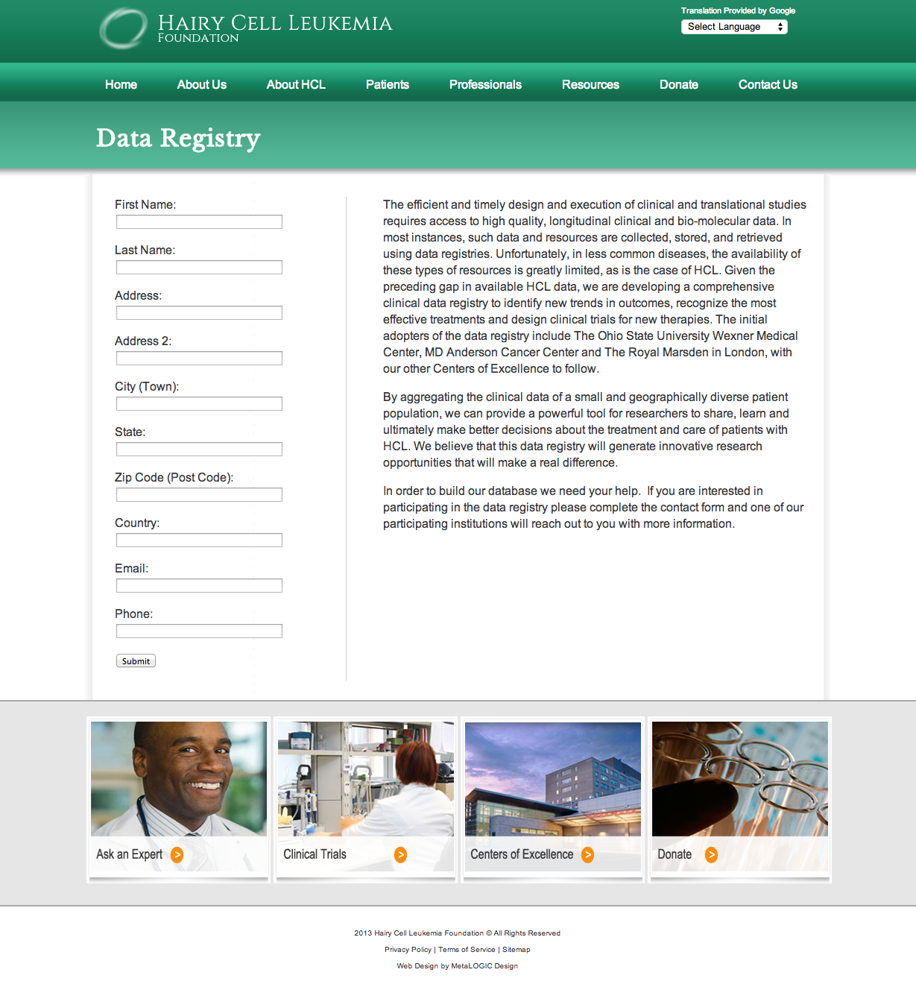

Slide 6
Registry Participation
Enrollment entails:
Signing Informed Consent
Signing HIPPA Consent
Providing a medical release of information
Providing your treating physicians’ names and contact information
Once someone’s information is in the registry, we will update it yearly or anytime there is a major change in their health status

Slide 7
De-Identification Pipeline
EHR
MDE
Identified Data Sources
Non-Identifiable Patient Data
One-way Hash Generator
Date Skewer
De-identified HCL Disease Registry
Extract First, Last Name & DOB
Eg. John Smith, 5/20/1950
Extract Dates
Clean & Normalize
Configure Range
Eg: 0 - 300 days
SHA1 Hash Generation
Temporal Date Skewer
Deidentified Patient Hash Code
Eg: 136a93f13ce6f350b95eed0faee6d d4ﬀ5eca042
Temporally Consistent Skewed Patient Dates Eg. : 15 Oct, 2012 -> 20 Dec, 2011
12 March, 2015 -> 16 May, 2014
De-identified Patient Data

Slide 8
Current Registry Participation
Centers of Excellence Participating:
Ohio State University
Royal Marsden Hospital
MD Anderson Cancer Center
University of Rochester
HCLF Web Portal
Annual patient enrollment estimates: 50

Slide 9
Patient Recruitment: Registry participation via HCLF website
Patient inquiries:
446 US
113 International
199 patients consented
154 Medical records acquired
140 Medical records uploaded

Slide 10
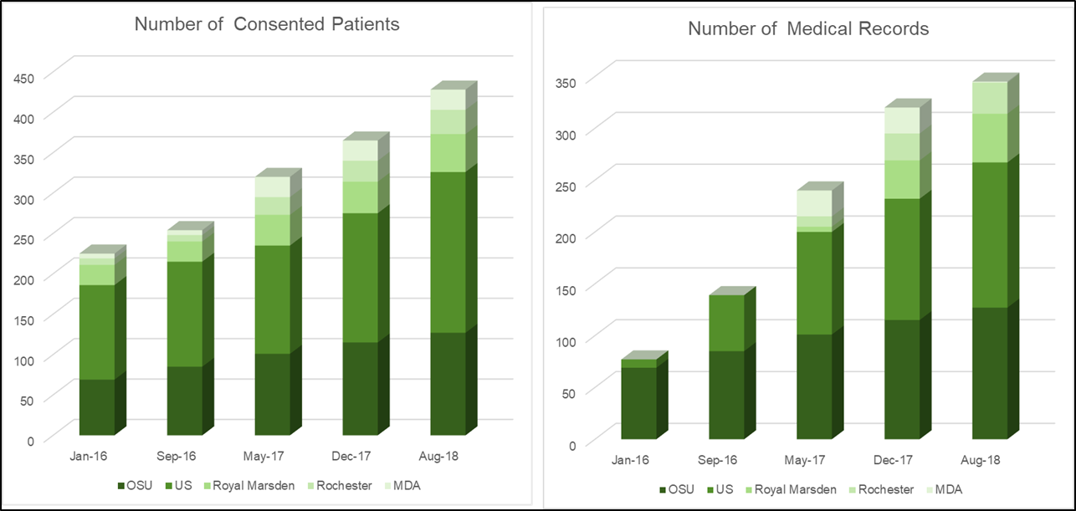
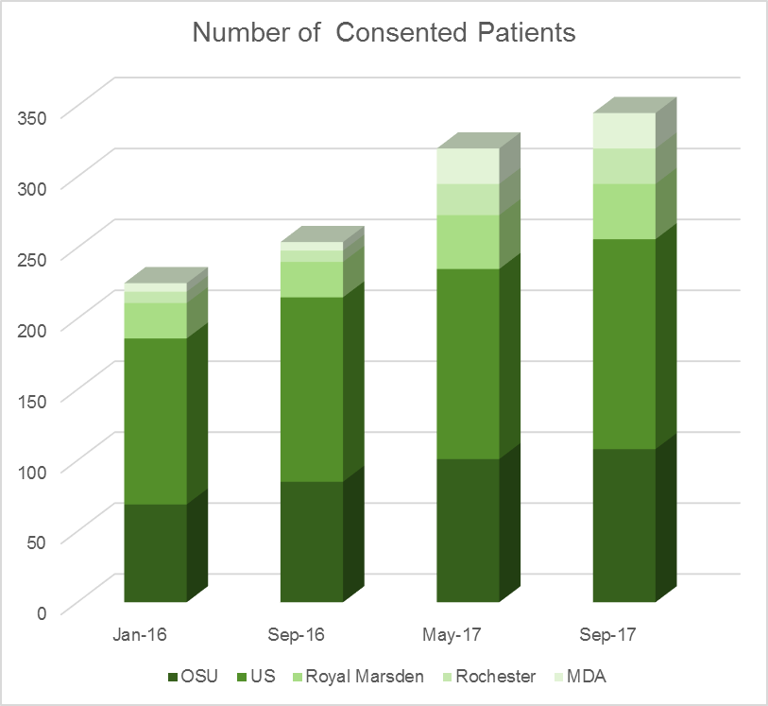
Registry Participation

Slide 11
Participants via HCLF website
MICB
Mayo
URMC
MSK
OSU
HNSM
NIH
Scripps
MDA

Slide 12
US participants
MALE
FEMALE

Slide 13
US participants
Older than 65 years
Age 50-65 years
Younger than 50 years

Slide 14
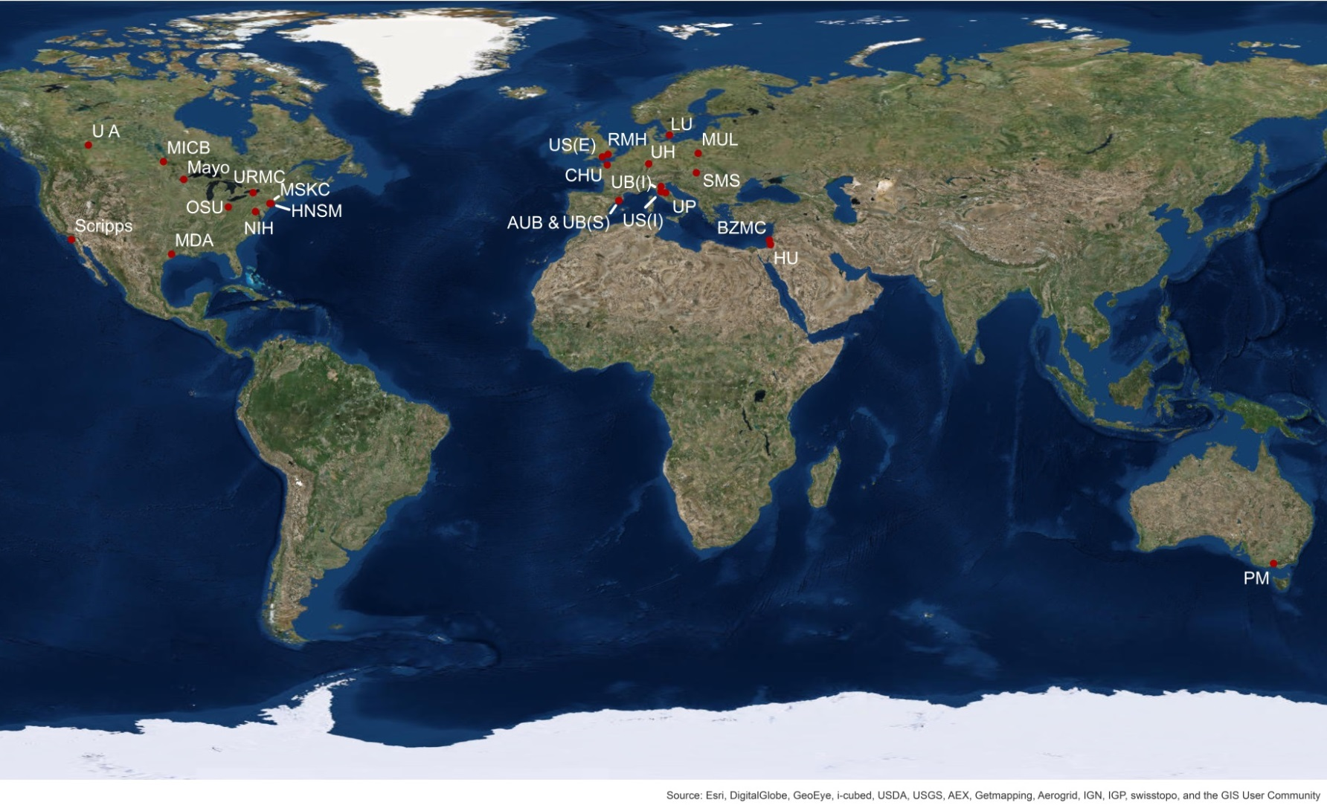
International Patients
UK 27
Australia 19
Canada 17
Brazil 5
Netherlands 6
Belgium 2
Ecuador 2
Iran 2
Ireland 2
Italy 5
New Zealand 2
Bulgaria 1
China 1
Finland 1
Germany 1
Greece 1
India 1
Israel 1
Nicaragua 1
Palestine 1
Pakistan 1
Russia 1
South Africa 2
Spain 1
Turkey 1
Venezuela 1

Slide 15
International Registry Participation:
A message from South Africa
“It is sad that
this happens …..again because
I live on the dark continent.
Our medical situation here with
rare diseases is terrible –
It is rare for ANY medical specialist
to have heard of HCL.
Thank you again.”

Slide 16
First Clinical Studies Using the Patient Data Registry
Updated Risk Stratification Analysis
Quality of Life and Clinical Outcomes of Hairy Cell Leukemia Patients
Impact of infections at the time of HCL diagnosis

Slide 17
Updated Risk Stratification in HCL
Most hematological malignancies have known prognostic factors that can help predict risk and outcomes
Difficult in HCL because it is so rare
Prediction of outcomes in HCL has not been updated since 1982
Predates effective therapies- standard treatment at the time was splenectomy
Based on physical measurement of spleen and hemoglobin values
Staging requires high quality data from a large, diverse group of patients
The HCL registry provides us with the opportunity to update staging and risk stratification in HCL
Include new genetic and molecular testing
Include outcomes from the newest treatment options
Goal: develop a new stratification system that can accurately predict risk and outcomes
Predict likely length of response to treatment
Predict who may require more intensive therapies

Slide 18
Quality of Life Study
First longitudinal study of QOL in HCL
Includes patients participating in the PDR
Participants complete QOL surveys at the time of diagnosis/first visit, then every 6 months for up to 5 years
Surveys will be completed either on a website or paper
Will merge data from surveys with clinical data
*Funded by a grant from the HCLF

Slide 19
Thanks to Our Teams
Our Patients
HCL Foundation
Ken Jensen
Brian Friedman
Mark Staudtmeier
OSU Team HCL
Michael R. Grever, M.D.
Mirela Anghelina, M.D.
James Blachly, M.D.
Gerard Lozanski, M.D.
Kerry Rogers, M.D.
Naren Epperla, M.D.
Christopher Oakes, Ph.D.
David Lucas, Ph.D.
OSU BMI
Omkar Lele (Moffitt)
Chris Heckler
Puneet Majur
Soledad Fernandez
HCL Collaborators
Clarie Dearden, M.D.
Farhad Ravandi, M.D.
Clive Zent, M.D.
Matthew Cross, M.D.
Daniel Catovsky, M.D
Francesco Forconi, M.D.
Versha Benerji, M.D.
James Johnston, M.D.
Martin Tallman, M.D.
Robert Kreitman, M.D.
-And the rest of the HCLF Researchers and CRC’s
This research was made possible by the Hairy Cell Leukemia Foundation
with additional support from the SASS Foundation

Slide 20
Thank you!

